Slide 1
Individual Differences & Assessment
Chapter 3
1 | 2 | 3 | 4 | 5 | 6 | 7 | 8 | 9 | 10 | 11 | 12 | 13 | 14 | 15 | 16 | 17 | 18 | 19 | 20
21 | 22 | 23 | 24 | 25 | 26 | 27 | 28 | 29 | 30 | 31 | 32 | 33 | 34 | 35 | 36 | 37 | 38 | 39 | 40
41 | 42 | 43 | 44 | 45 | 46 | 47 | 48 | 49 | 50 | 51 | 52 | 53 | 54 | 55 | 56 | 57 | 58 | 59 | 60
61 | 62 | 63 | 64 | 65 | 66 | 67 | 68 | 69 | 70 | 71 | 72 | 73 | 74 | 75 | 76 | 77 | 78 | 79 | 80

Slide 2
Overview
Module 3.1 – Introduction to Individual Differences
Module 3.2 – Human Attributes
Module 3.3 – Foundations of Assessment
Module 3.4 – Assessment Procedures
Module 3.5 – Special Topics in Assessment
Notes:
Generally content is discussed within module. Exception: testing of personality and integrity and emotional intelligence

Slide 3
Module 3.1 – Introduction to Individual Differences

Slide 4
Introduction to Individual Differences
Individual Differences – dissimilarities between or among two or more people
Background
1890 – Cattell & concept of “mental test”
Mental test – instrument designed to measure a subject’s ability to reason, plan, and solve problems
Differential psychology – study of individual differences
Psychometrics – practice of measuring a characteristic such as mental ability, placing it on a scale or metric

Slide 5
Reminder: Goals in Identifying Useful Individual Differences
Reliable
Construct Valid
Correlated with what it should be (convergent validity)
Not correlated with what it shouldn’t be (discriminant validity)
Criterion-related validity

Slide 6
Fundamental Assumptions in Applying Individual Differences Model
Adults have a variety of attributes that are _______________ over a period of time
________________ with respect to those attributes
Relative differences among people on these attributes ______________________
Different _____________________________
These attributes ___________________

Slide 7
Today’s Individual Differences
Commonly referred to as KSAOs
Cognitive Abilities (A)
Physical Capabilities (A/O)
Knowledge (K)
Skills (S)
Interests (O)
Personality (O)

Slide 8
Module 3.2 – Human Attributes

Slide 9
Cognitive Ability
Involves ability to reason, plan, solve problems, comprehend complex ideas, & learn from experience
aka intelligence, general mental ability (GMA), cognitive ability, intellectual capacity
The Old Way
Intelligence Quotient (IQ)
The New Way
Spearman’s g
Fleishman’s s
Cattell’s theory
Crystallized intelligence
Fluid intelligence

Slide 10
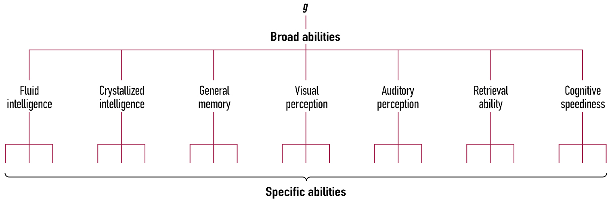
Carroll’s Hierarchical Model
Figure 3.2
Carroll’s
Hierarchical Model
Source: Carroll (1993).

Slide 11
g and Time
At the individual level
Gradually ________________ as we age (roughly 0.5 IQ pt / year)
Fluid intelligence decreases while crystallized intelligence increases
At the group level
Gradually ________________ with new generations
The Flynn Effect (+ 1 SD)

Slide 12
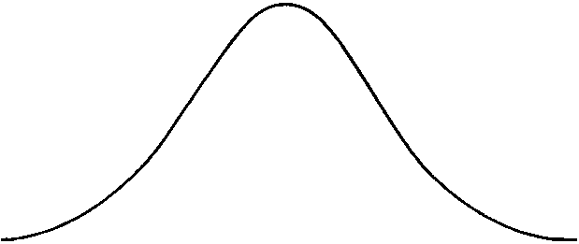
Racial Differences in g
Af
H
W
As

Slide 13
Cognitive Ability Tests (cont’d)
Is “g” important at work?
“Yes”, g predicts performance across many jobs
↑ job complexity = ↑ predictive value of general intelligence tests
Pros:
85 years of research shown GCA (g) to be best predictor of future performance and learning/training (r = .51; Schmidt & Hunter, 1998)
Lowest costs & most research & theory
Cons:
Adverse impact

Slide 14
“Supplemental Types” of Intelligence
Emotional Intelligence (EQ)
“The ability to perceive and express emotion, assimilate emotion in thought, regulate emotion in self and others”
Example items
“I almost always know exactly how I’m feeling”
“The variety in human beings makes life interesting”
“I try to think good thoughts no matter how badly I feel”
Is this intelligence?

Slide 15
Physical Abilities
Physical abilities
Muscular strength
How much?
Cardiovascular endurance
How long?
Movement quality
How well?
Use in organizations

Slide 16
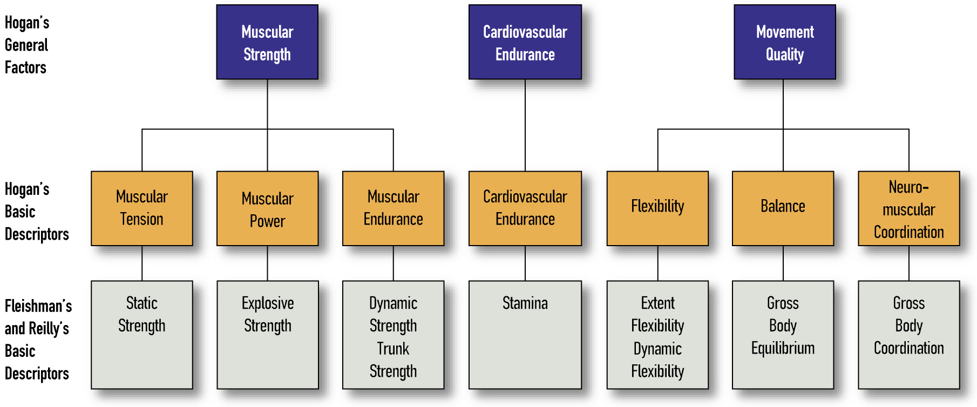
A Model of Physical Abilities
Figure 3.3: A Model of Physical Abilities
SOURCE: (Guion, 1998)

Slide 17
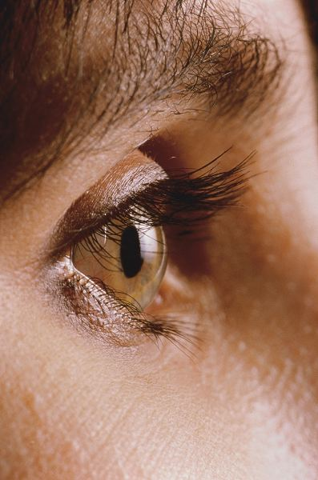
Sensory Abilities
Vision
Touch
Taste
Smell
Hearing
Kinesthetic feedback
Use in organizations
Jeff Maloney/Getty Images

Slide 18
Psychomotor Abilities
Also called sensorimotor or motor abilities
Fleishman’s psychomotor abilities
Arm-hand steadiness
Manual dexterity
Finger dexterity
Control precision
Response orientation
Rate control
Reaction time
Wrist-finger speed

Slide 19
Knowledge
Labels, facts, rules, procedures, plans, or goals pertaining to objects, events, processes, conditions, goals, objectives, or the self (Campbell, 2001)
Several proposed structures
Cognitive psychology
Declarative knowledge and procedural knowledge
Sternberg
Academic and tacit knowledge
Use in organizations

Slide 20
Skills
Two major categories
Application of knowledge to solve a specific problem with a known solution
Application of knowledge and observable skills to solve problems without a known solution
Use in organizations

Slide 21
Vocational Interests
One of the oldest individual difference measures
Tendency to enjoy particular surroundings or activities
Holland’s vocational typology tends to dominate this entire area
Realistic
Investigative
Artistic
Social
Enterprising
Conventional

Slide 22
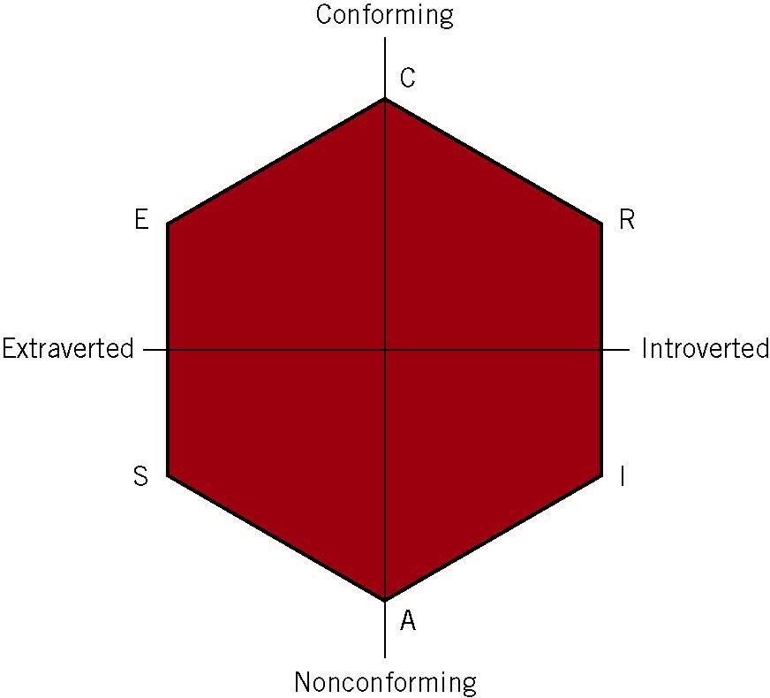
Holland’s Vocational Typology
Figure 3.4
Interest Types
Underlying the Hexagonal
Representation of Holland’s
Vocational Typology
Source: Hogan & Blake (1996).

Slide 23
Vocational Interests
Do vocational interests predict (1) academic performance or (2) job performance?
Nye, Su, Rounds, & Drasgow (2012) conducted a meta-analysis
Interest score & academic performance, ρ = .23
Interest match & academic performance, ρ = .32
Interest score & job performance, ρ = .20
Interest match & job performance, ρ = .36

Slide 24
Personality
Current major focus in I/O
Generally, a relatively stable set of characteristics, tendencies and traits (not states)
Why does this matter?
Many potential personality traits

Slide 25
Personality
Personality interacts with the situation to influence behavior
Personality can help predict job performance
Measurement of psychopathology vs. normal personality

Slide 26
Personality Measure Development
Empirically-derived
Items written first, no cohesive theory
Hathaway’s Minnesota Multiphasic Personality Inventory (MMPI)
Theoretically-derived
Meyers-Briggs Type Inventory (MBTI)
Rational or Trait approach
Organizes personality into a hierarchy
Big Five / Five Factor Model
Costa & McCrae, Goldberg

Slide 27
The Five Factor Model (FFM)
Five Factors and their respective Facets:
“OCEAN”
Openness to Experience
Conscientiousness
Extraversion
Agreeableness
Neuroticism / Emotional Stability
(Mostly) Universal, cross-cultural hierarchy

Slide 28
Openness to Experience
Those high in openness tend to be more curious, imaginative, playful, and artistically inclined than others.
Facets
Fantasy, Aesthetics, Feelings, Ideas, Actions
Example Item
I spend time reflecting on things. (+)
On a vacation, I prefer to go back to a tried and true spot. (–)

Slide 29
Conscientiousness
Favors organization, dependability, and achievement-orientation.
Facets
Competence, Order, Dutifulness, Achievement-Striving, Self-Discipline, Deliberation
Example Item
I am exacting in my work. (+)
Over the years I’ve done some pretty stupid things. (–)

Slide 30
Extraversion
Sociability of an individual
Facets
Gregariousness, Activity, Excitement-Seeking, Positive Emotions, Assertiveness
Example Item
I am dominant, forceful, and assertive. (+)
I often feel uncomfortable around others. (–)

Slide 31
Agreeableness
The degree of courtesy, trusting, cooperation, and tolerance a person exhibits.
Facets
Straightforwardness, Modesty, Altruism, Compliance, Trust
Example Items
I sympathize with others’ feelings. (+)
I am not interested in other people’s problems. (–)

Slide 32
Neuroticism / Emotional Stability
Neurotic individuals tend to lack emotional adjustment
Facets
Anxiety, Anger, Depression, Vulnerability, Impulsiveness
Example Item
I get upset easily. (+N/-ES)
I am relaxed most of the time (–N/+ES)

Slide 33
FFM Test Characteristics
Reliability
Generally high: a = 0.8-0.9
Valid
Barrick & Mount (1991)’s meta-analysis of criterion-related validity
Conscientiousness – job performance = .22
Extraversion – training performance = .26
Openness – training performance = .25
Others – both = ~.00
Compound traits

Slide 34
FFM Test Characteristics
More Barrick & Mount (1991)
Conscientiousness criterion-related validities
Job performance = .22
Training performance = .23
Productivity = .17
Salary = .17
Consistently valid predictor across all occupational groups studied and all criterion types
Hurtz & Donovan (2000) expanded
Agreeableness & neuroticism predict contextual performance

Slide 35
Integrity
Quality of being honest, reliable, and ethical
Overt measures
E.g., How often have you arrived at work under the influence of alcohol?
Predict overall job performance better
Personality-based measures
E.g., Are you a risk taker?
Predict CWBs better
Concerns about faking

Slide 36
Personality & Faking
Occurrence
In the lab
The “fake good” and “fake bad” methods
In the field
High-stakes testing
Hard to detect
Detection
Lie detection scales
Overt vs. personality-based integrity testing
Effect on Validity

Slide 37
Group Discussion
Consider the job of “professor.” Which of these individual differences are relevant to this job?

Slide 38
Module 3.3 – Foundations of Assessment

Slide 39
What is a Test?
Objective & standardized procedure for measuring a psychological construct using a sample of behavior
Attributes to be assessed _______________
Ways to assess attributes _______________

Slide 40
What is a Test
What is the meaning of a test score?
Norming & norm groups used to interpret and give meaning to a score
Test users & test interpretation
Importance of training test administrators to correctly understand & interpret results
Test battery
Collection of tests assessing variety of different attributes

Slide 41
Administrative Test Categories
Speed vs. power tests
_______________ have rigid & demanding time limits
Provide greater variability among candidates
Issue of relevance to job
May increase the risk of legal challenges
_______________ have no rigid time limits
Questions answered correctly by a smaller percentage of test takers

Slide 42
Administrative Test Categories
Group vs. individual tests
Individual tests useful in assessing a candidate’s style of problem solving
Group testing is valuable in reducing costs
Paper & pencil vs. performance tests
Performance tests assess skill in performing tasks & knowledge of how to carry out actions

Slide 43
Testing & Culture
Bias
Situation in which a given test results in statistical errors of prediction for a subgroup
Fairness
Value judgment about actions or decisions based on test scores

Slide 44
Module 3.4 – Assessment Procedures

Slide 45
Cognitive Ability Tests
Allow individuals to demonstrate what they know, perceive, remember, understand, or can work mentally
Includes problem-solving, perceptual skills, developing or evaluating ideas, and remembering what one has learned

Slide 46
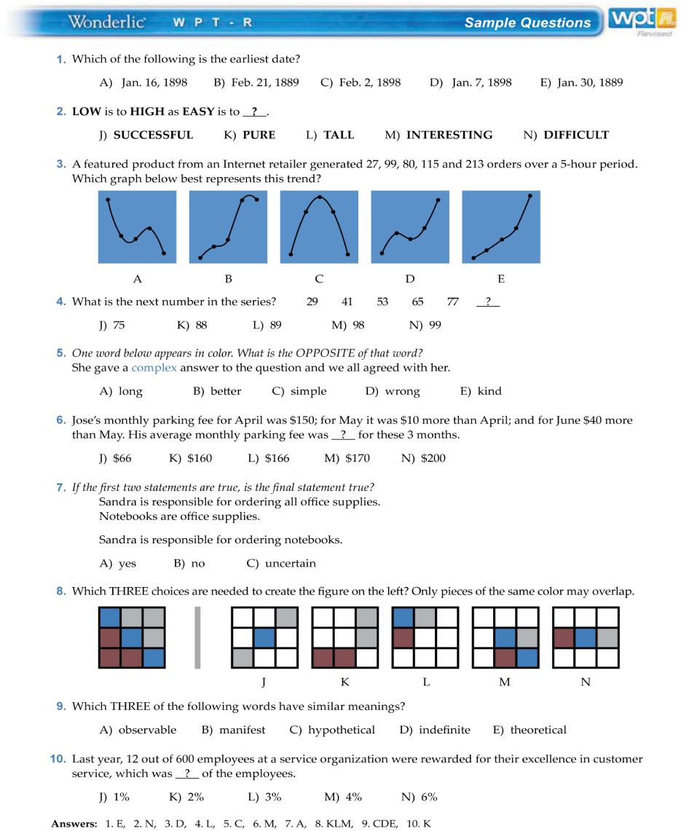
Cognitive Ability Tests (cont'd)
Tests that produce a single score
e.g., Wonderlic Personnel Test (WPT) – 50 items to assess verbal, numerical, and spatial abilities
12 minute administration (speed test)
High reliability and strong correlations with other, more elaborate, intelligence tests
Used by the NFL

Slide 47
Cognitive Ability Tests (cont'd)
Tests of specific abilities
e.g., Bennett Test of Mechanical Comprehension
Other tests measure perceptual accuracy, memory, spatial relations, etc.
Cognitive test batteries
Collection of tests that assess a variety of cognitive aptitudes or abilities
General Aptitude Test Battery (GATB)
Federal government uses in selection
Armed Services Vocational Aptitude Battery (ASVAB)

Slide 48
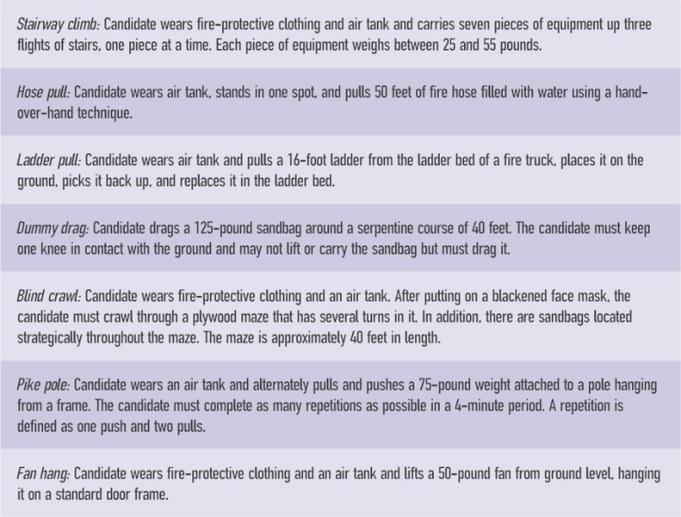
Physical Ability Tests for Firefighters

Slide 49
Testing Methods
Interview
Assessment Center
Work Samples
Situational Judgment Test

Slide 50
Interview
Tend to cover job knowledge, abilities, skills, personality, & person-org. fit
Structured vs. Unstructured Interviews
Structured interviews have higher validity
Unstructured interviews tend to be preferred by hiring managers
Situational vs. Behavioral Interviews
Situational: what would you do if…
Behavioral: what did you do when…

Slide 51
Assessment Centers
Collection of procedures used for evaluation, often for possible promotion
Typical characteristics
Assessment done in groups
Assessment done by groups (i.e., assessors)
Multiple methods of assessment employed
Assessment centers have “feel” of relevance

Slide 52
Work Sample Tests
Measure job skills by taking samples of behavior under realistic, job-like conditions
Examples:
Rudder control test for pilots
Speech interview for foreign student

Slide 53
Situational Judgment Tests
Present candidate with written scenario, then ask candidate to choose best response from series of alternatives
Important characteristics:
Job-related
Well-accepted by test takers
Reduced adverse impact compared to other devices

Slide 54
Module 3.5 – Special Topics in Assessment

Slide 55
Biodata
Biodata
Includes type of information collected on an application blank
e.g., previous jobs, education, & special training
Ecology model
Events constituting person’s history represent choices made by individual to interact with his/her environment

Slide 56
Grades & Letters of Recommendation
May be able to predict job offers, but not job success
Little serious research on validity & fairness of these devices

Slide 57
Computer-Based Assessment
Are we measuring the same thing we do with paper & pencil test or interview?
Yes AND No
Personality tests – YES (Salgado & Moscoso, 2003)
SJT, biodata, and personality – YES (Ployhart et al., 2003)
g – generally yes, unless test is speeded
Computer-based testing puts limits on test-taking “style”
Sometimes can’t go back and forth
Screen may only display one or two items

Slide 58
Internet-Based Testing
Can be expensive – more useful for organizations that screen a large number of applicants
Unproctored – concerns about faking and cheating
Need to verify answers before hiring

Slide 59
Internet-Based Testing
Who is the a candidate
Individual submits expression of interest in employment
Employer considers individual for employment
Individual possesses basic qualifications for the position
Individual does not withdraw from further consideration
Computer Adaptive Testing – test identifies test taker’s level of ability and only asks questions to further refine ability level

Slide 60
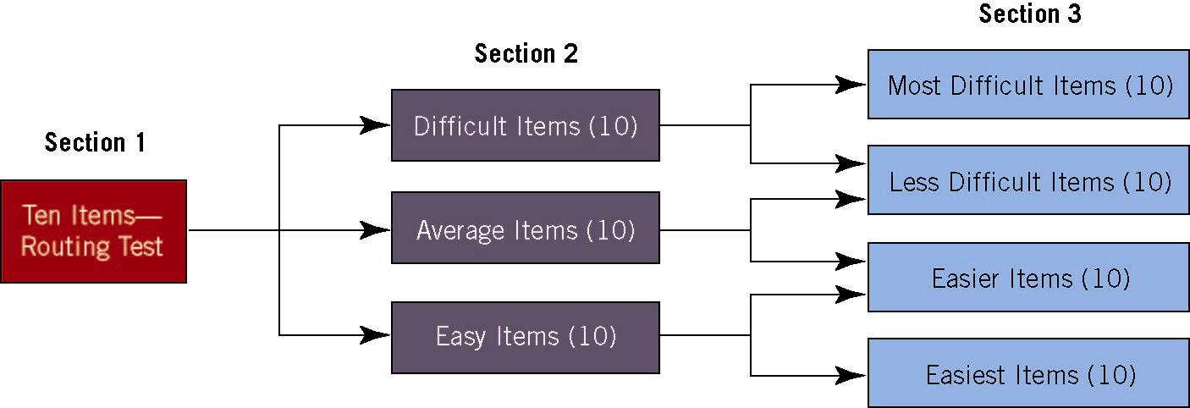
Routing Test in Computer Adaptive Testing
Figure 3.13.

